Slide 1
Project Requirement and Specification on Voice Based E-mail for Visually Challenged (CSE IV Semester Mini project) 2021-2022 DEPARTMENT OF COMPUTER SCIENCE AND ENGINEERING GRAPHIC ERA DEEMED TO BE UNIVERSITY DEHRADUN, UTTRAKHAND
Submitted to:
Mr. Pankaj Kumar
(Mini Project Evaluator) Guided by:
Mr. Saurabh Mishra (Resource Person)
Submitted by: Ms. Meenal Phartiyal Roll. No: 2014723
(CSE-D-4th-Sem)
Session: 2021-2022

Slide 2
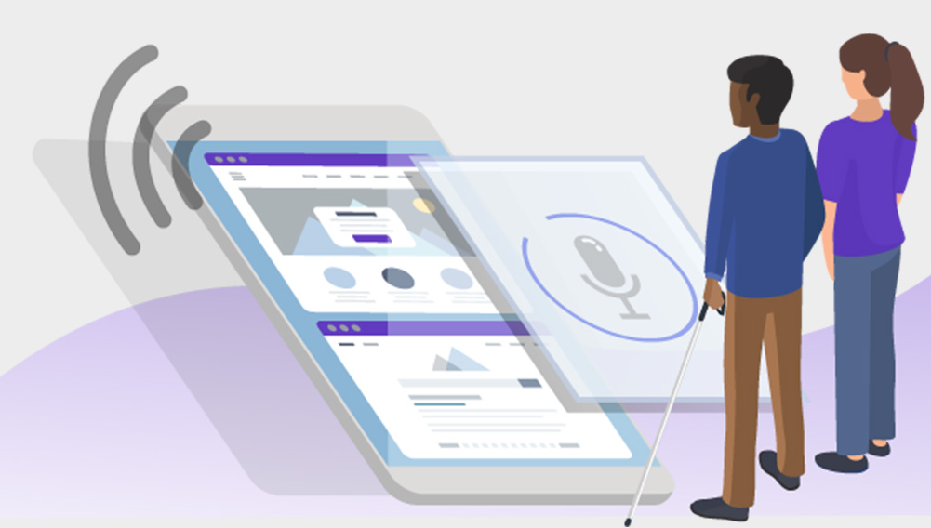

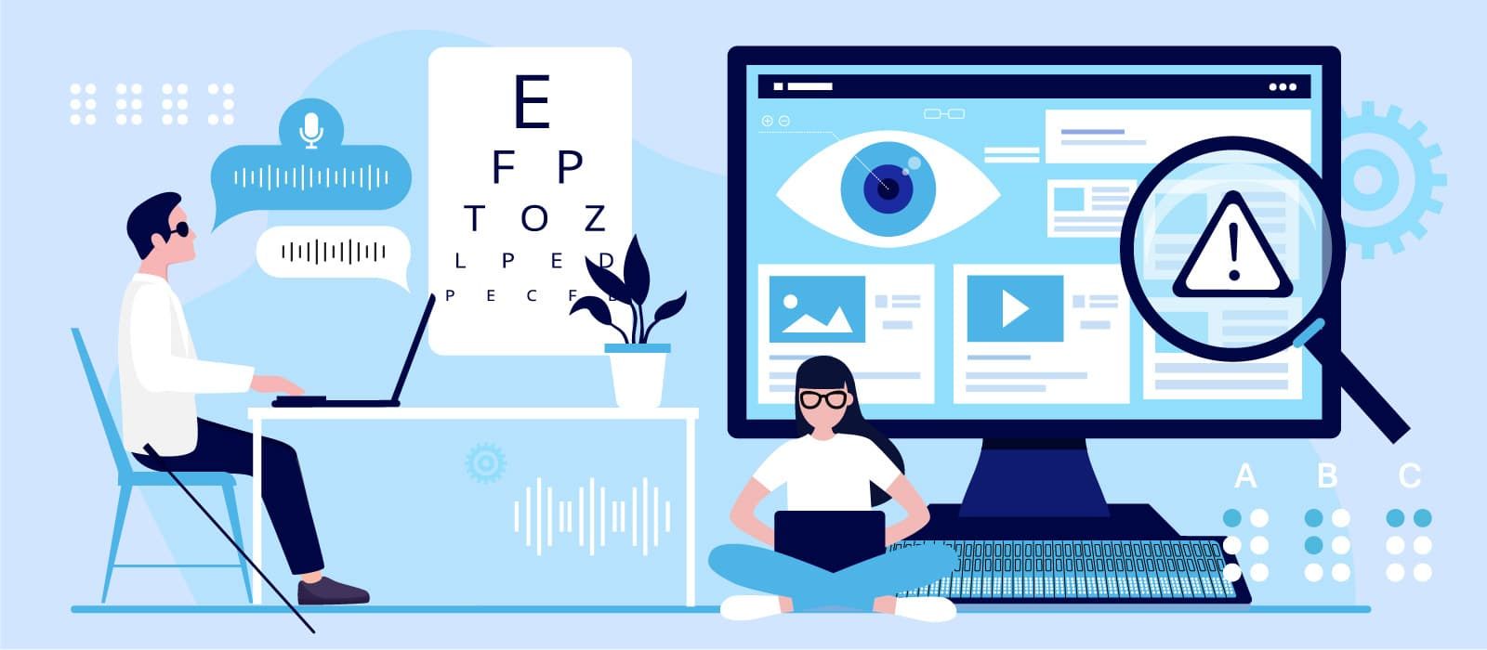
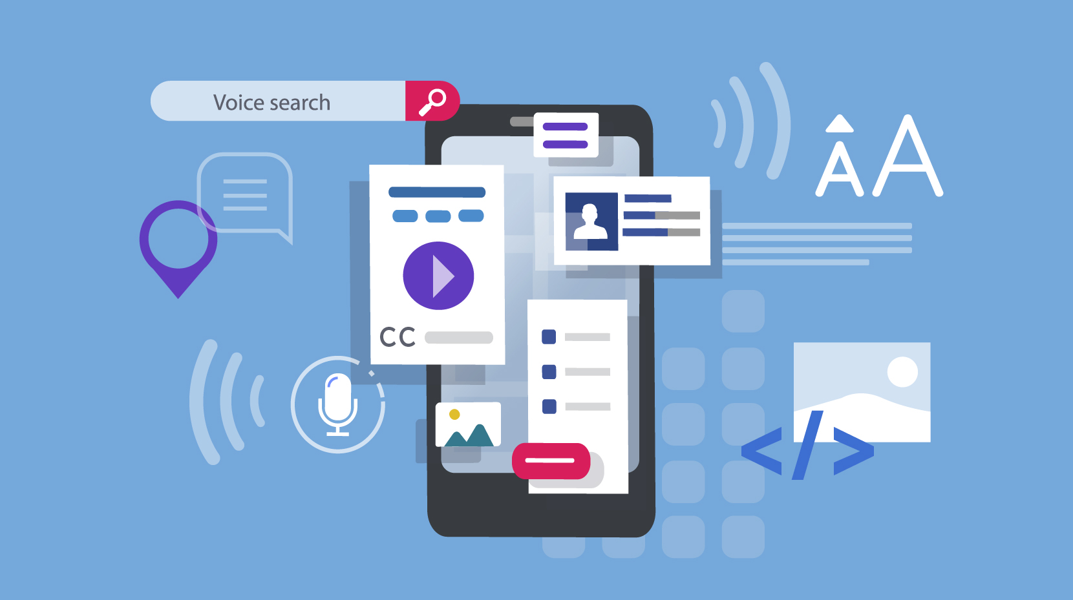

About Project

Slide 3
Design
Phase 1
The tasks that can be performed using the program developed will be prompted using the voice prompt. In background python module pyttsx3 is used for text to speech conversion.
User will be asked to provide input for the following tasks written below. The input is expected in the form of speech by the user which will be converted to text by the Google speech application interface in python and accordingly tasks will be performed.
Login to their Gmail account.
Send e-mail through Gmail.

Slide 4
Design
Phase 2
In phase-2 of our program the user will give speech input to the system. This speech input will be handled by speech_recognition module.
It is a python library which is used to handle the voice requests and it converts speech into text.
Now after receiving input from the user speech to text converter will save the response in respective variables used in the script and based on their value it will further enter into respective modules.

Slide 5
Design
Phase 3
In this phase our program will handle the requests by the user. Based on the speech input given by the user it will launch the modules.
Login to G-mail account: This module will handle the request by user to login in their g-mail account.
Send E-mail through G-mail: This module will handle the request by user to send email through their g-mail account. And then it will allow the user to speak their message and send the mail.

Slide 6
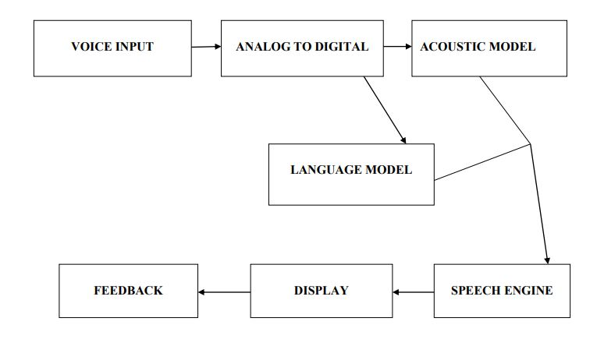

Slide 7

Requirement of Project
Software Requirement
Python IDLE.
Interpreters for scripts
Google Speech-to-text and text-to-speech Converters.
Pyttsx text to speech API in python
Hardware Requirement
Personal Computer

Slide 8
OUTPUT

Slide 9
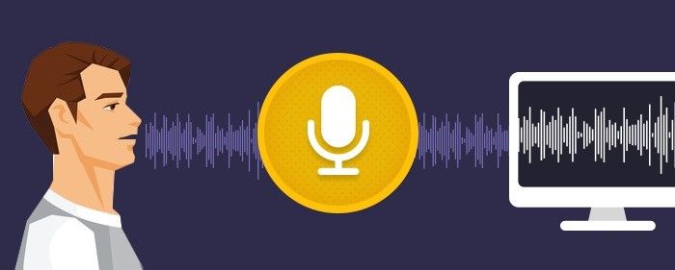
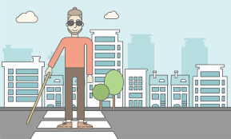
Motivation
This project is proposed for the betterment of society. It aims to help the visually impaired people to be a part of growing digital society by using internet and also aims to make life of such people quite easy.
Also, the success of this project will encourage developers to build something more useful for visually impaired or illiterate people, who also deserves an equal standard in society.

Slide 10
Conclusion
The project that I have presented is a system which will help the visually impaired people to access email services efficiently. This system will help in overcoming some drawbacks that were earlier faced by the blind people in accessing emails. I have eliminated the concept of using keyboard shortcuts along with screen readers which will help reducing the cognitive load of remembering keyboard shortcuts. Also, any non-sophisticated user who does not know the position of keys on the keyboard need not bother as keyboard usage is eliminated. Other than this the user might need to feed in information through voice inputs when specified. This architecture will reduce cognitive load taken by blind to remember and type characters using keyboard. It also helps handicapped and illiterate people.

Slide 11
Thank You!

